Slide 1

A Journey Through the Evolution of Scientific Thought by
Dr Hage Doley
Assistant Professor

Slide 2
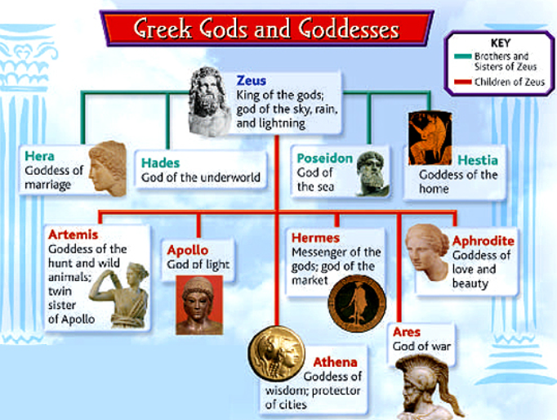
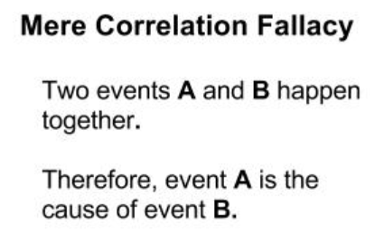
Ancient Superstitions
Explaining complexity with complexity.
Everything had supernatural agency; lacking a systematic method for causation verification.
Mythologies driven by correlation/causation fallacy.
This led to diverse mythologies across cultures, but no unified understanding of nature

Slide 3
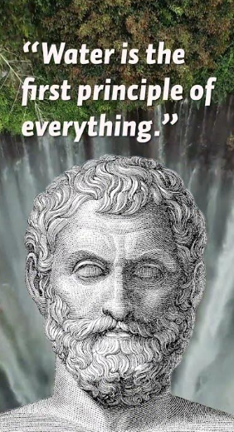
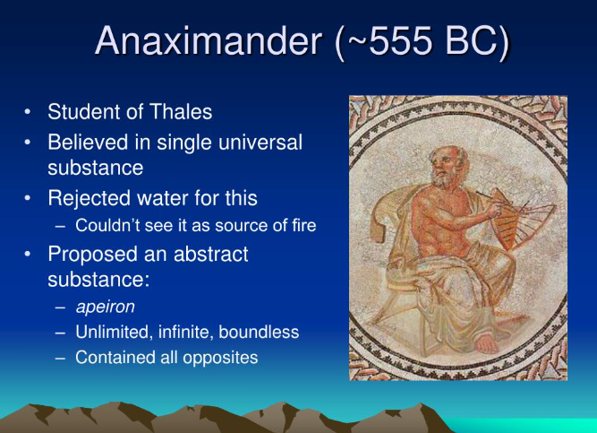
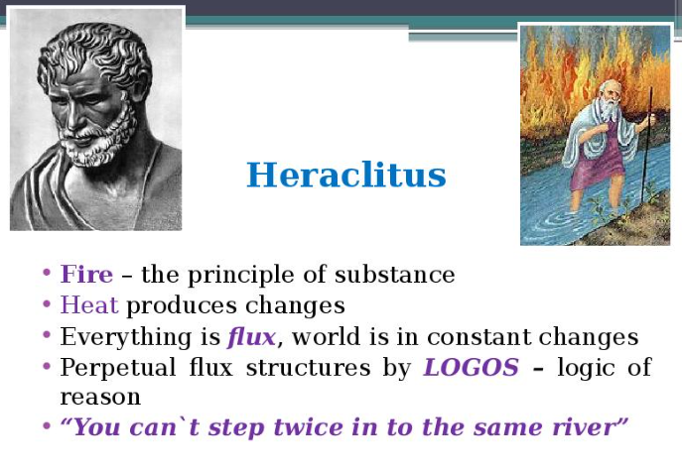
Thales’ Leap
Thales (6th Century BC): Explained complexity with simplicity.
  Claimed water as the foundational principle.
  Introduced coexistence of natural laws and gods.
  marked the beginning of naturalistic explanations
  shift from supernatural to natural explanations laid the groundwork for future scientific inquiry
Followed by:
  Anaximander’s "Indefinite" (Apeiron).
  Anaximenes’ "Air."
  Heraclitus’ "Fire.“
Explanations wrong but in the right direction.

Slide 4
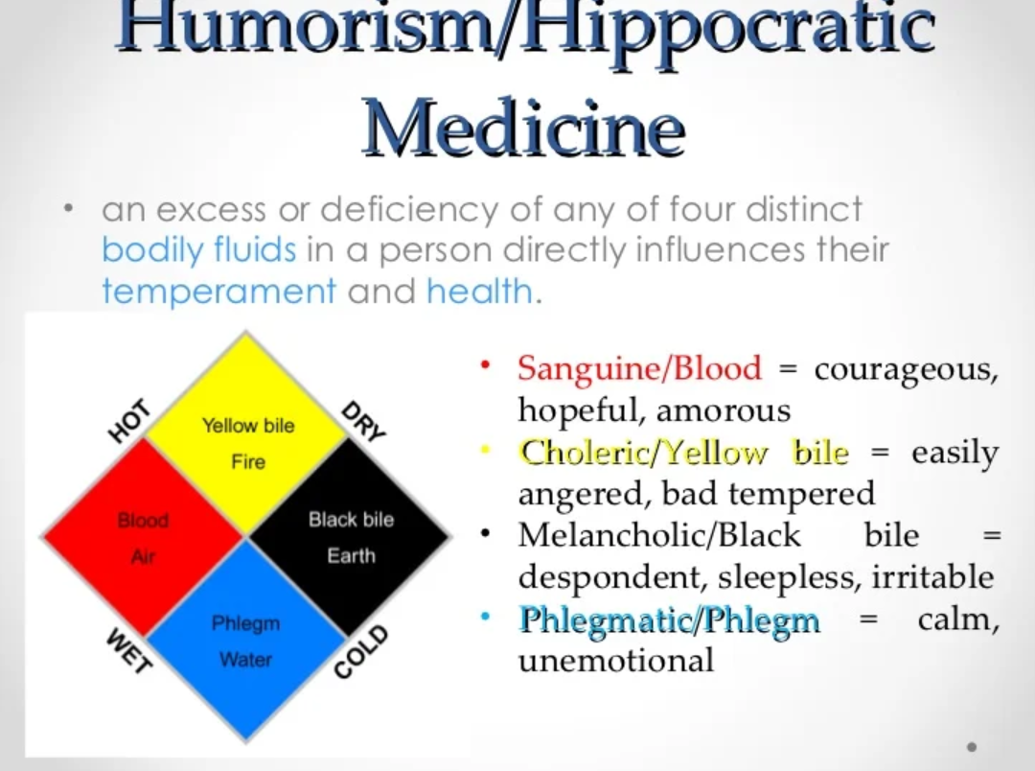
Hippocrates: The Father of Medicine
Shifted medical thinking from supernatural to natural explanations for diseases.
Proposed that diseases were caused by imbalances in bodily fluids (humors):
  Blood
  Yellow Bile
  Black Bile
  Phlegm
Humoral imbalance led to illness and health issues.
Moved away from beliefs like demonic possession or divine punishment.
Focused on understanding the body and disease through naturalistic causes.
Though later debunked, Hippocrates' ideas marked a critical step toward scientific and naturalistic approaches to medicine.

Slide 5
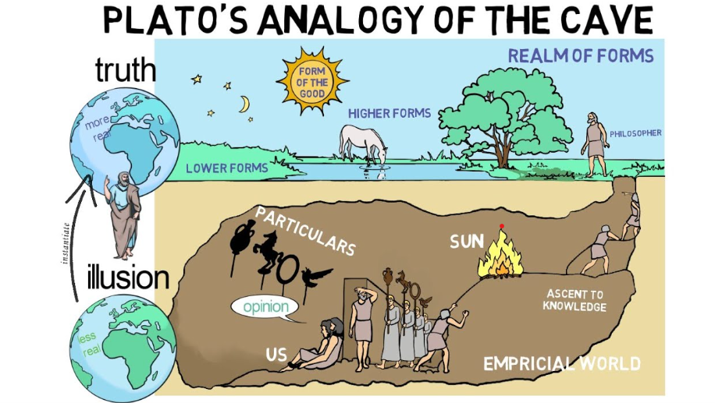
Plato’s Two-World Model (427-347 BC)
introduced the idea of a perfect, immaterial world of forms, distinct from the imperfect material world.
Natural and supernatural worlds separated.
Timaeus: Nature exhibits order, implying a designer.
Material world: Governed by laws but only a "shadow" of perfect forms.
While he acknowledged natural laws, he prioritized philosophy over empirical science, viewing the material world as a shadow of the true reality.

Slide 6
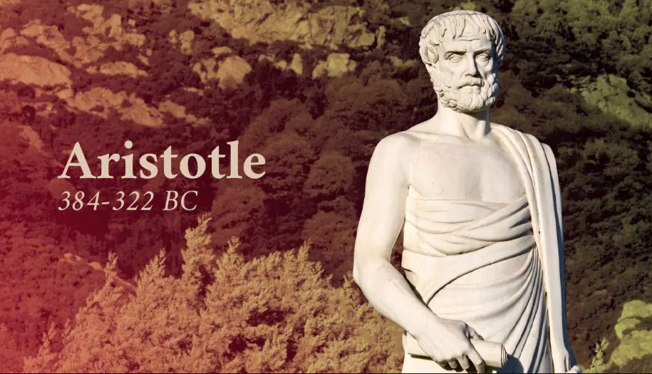
Aristotle and Reassertion of Nature
Aristotle focused on the natural world as the primary object of study
Introduced the concept of “final cause” (telos)—objects have a purpose.
Promoted empirical observation for understanding growth and change.
Rejected "world of forms," acknowledged a divine mover.
His work restored the importance of science and laid the foundation for future empirical investigations.

Slide 7
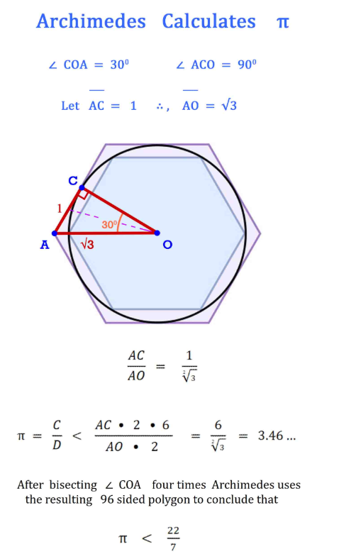
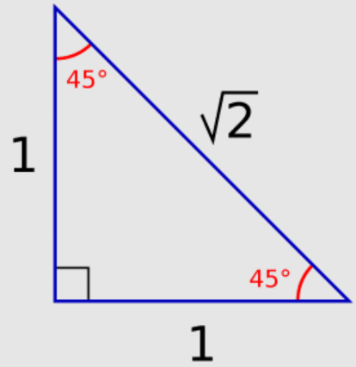
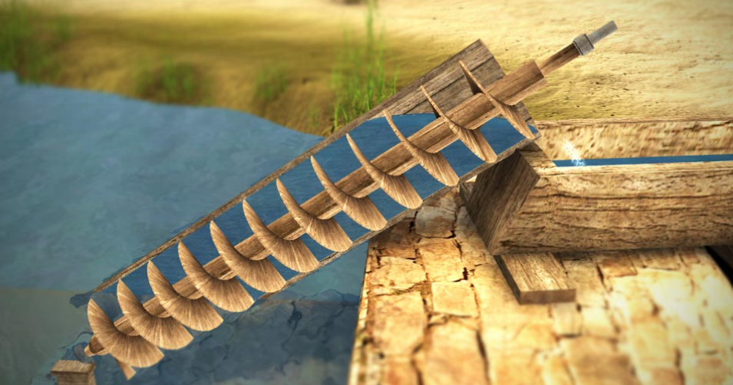
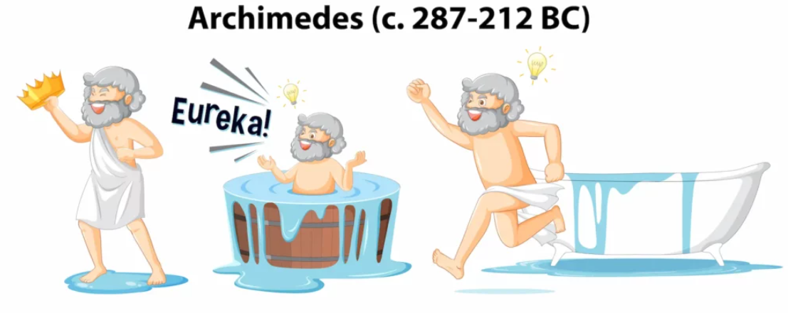
Archimedes and Introduction to Mathematics
Pythagorean cult centred on the divine nature of integral ratios (rational numbers).
Hipparus discovered irrational number.
Archimedes applied mathematics to physical problems, demonstrating its utility in understanding the natural world.
Archimedes’ principle of floating bodies.
Invented tools like Archimedes’ screw.
Demonstrated math’s power in understanding nature.
bridged the gap between abstract mathematics and practical science.

Slide 8
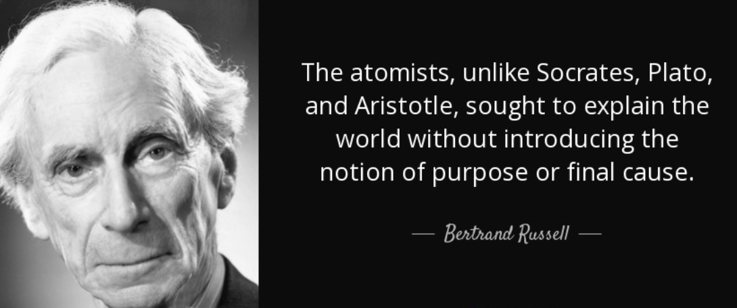
The Atomists and Materialism
Democritus, Epicurus, and Lucretius proposed that the universe is composed of indivisible atoms moving through void space.
  Universe governed by chance, no divine plan.
Lucretius’ De Rerum Natura: Denied creation out of nothing.
Their materialistic worldview rejected supernatural explanations, aligning with modern scientific principles but lacked experimental backing.

Slide 9
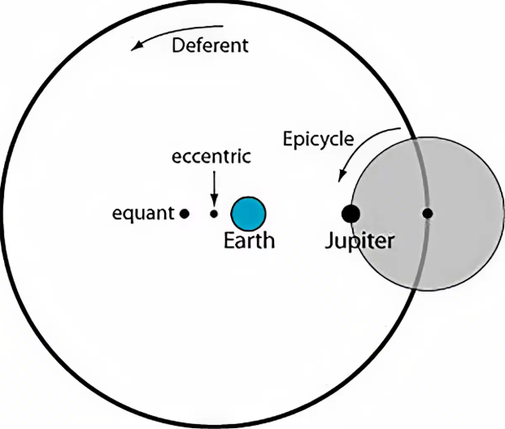
Geocentrism vs. Heliocentrism and theory of choice
Ptolemy: Geocentric model using epicycles and deferents.
Copernicus: Heliocentric model—simpler and elegant.
Importance of Occam’s Razor: Prefer simpler theories.

Slide 10
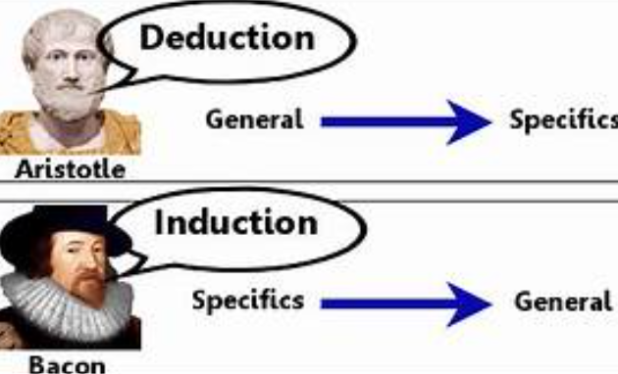
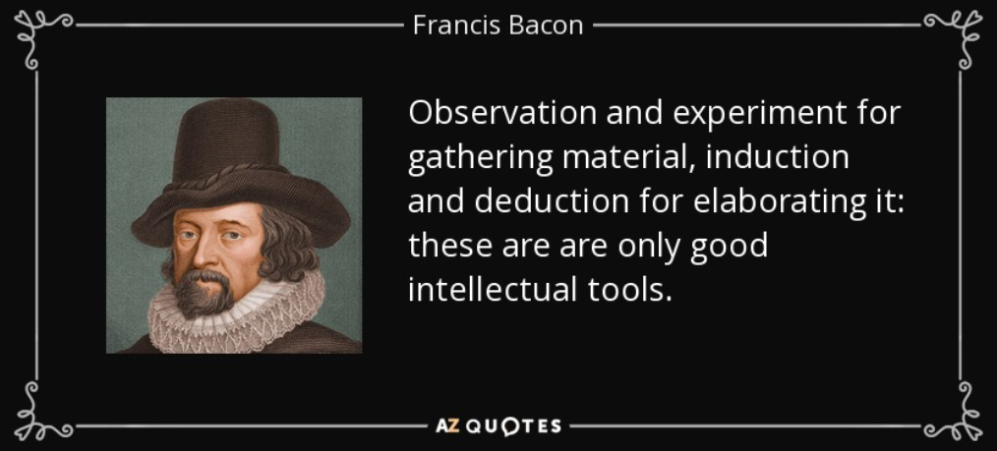
Francis Bacon and Inductive Method (1561- 1626 AC)
Criticized deductive reasoning.
Introduced scientific method:
  Observation → Hypothesis → Experiment → Theory.
Emphasized experimentation over assumptions.

Slide 11
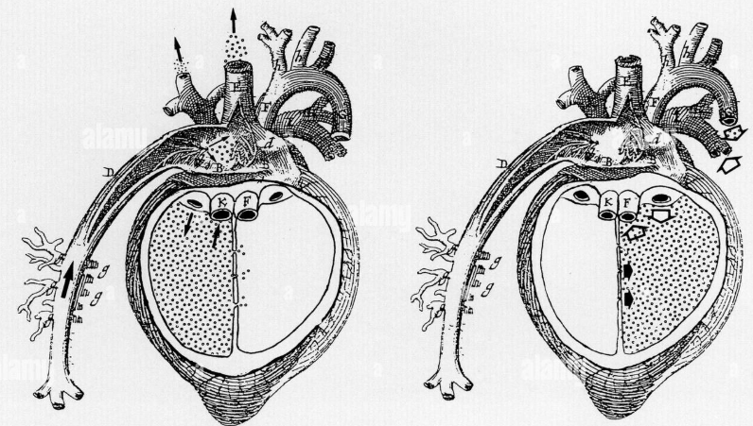
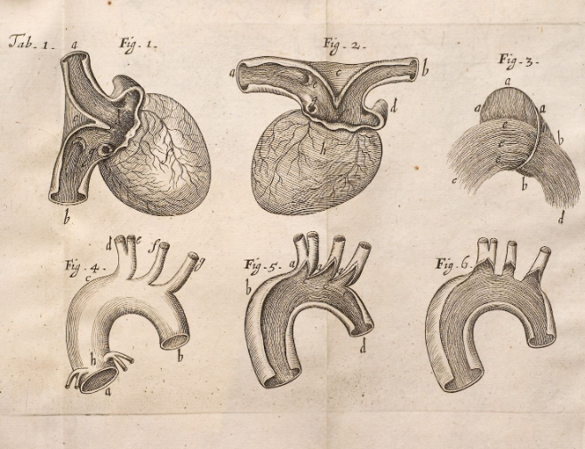
William Harvey and the Power of Demonstration
Dissected human hearts to challenge Galen’s theories.
Proved Galen’s ideas of blood circulation were incorrect.
Demonstrated the importance of independent empirical verification.

Slide 12
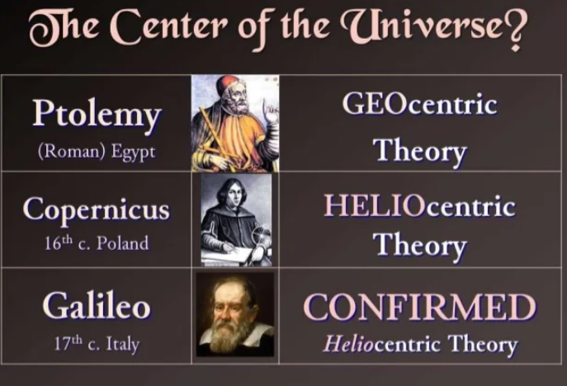
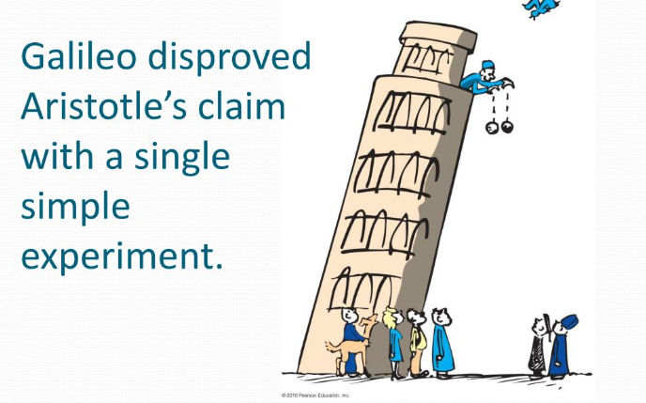
Galileo and the Fall of Aristotelian Physics
Proved:
  Heavy and light objects fall at the same rate.
  Earth’s rotation does not affect daily life.
Observed Jupiter’s moons—discrediting geocentrism.
underscored the importance of empirical evidence

Slide 13
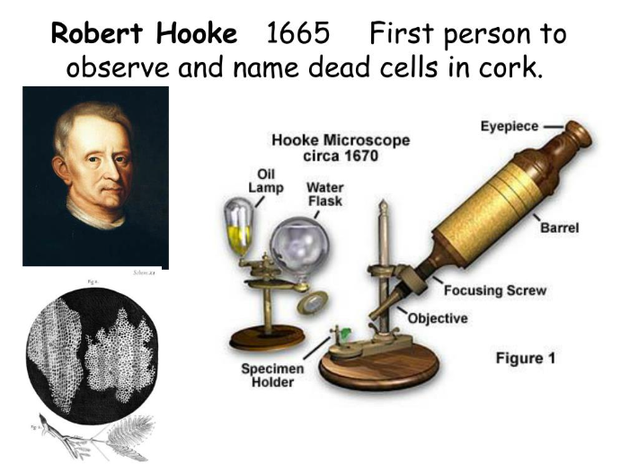
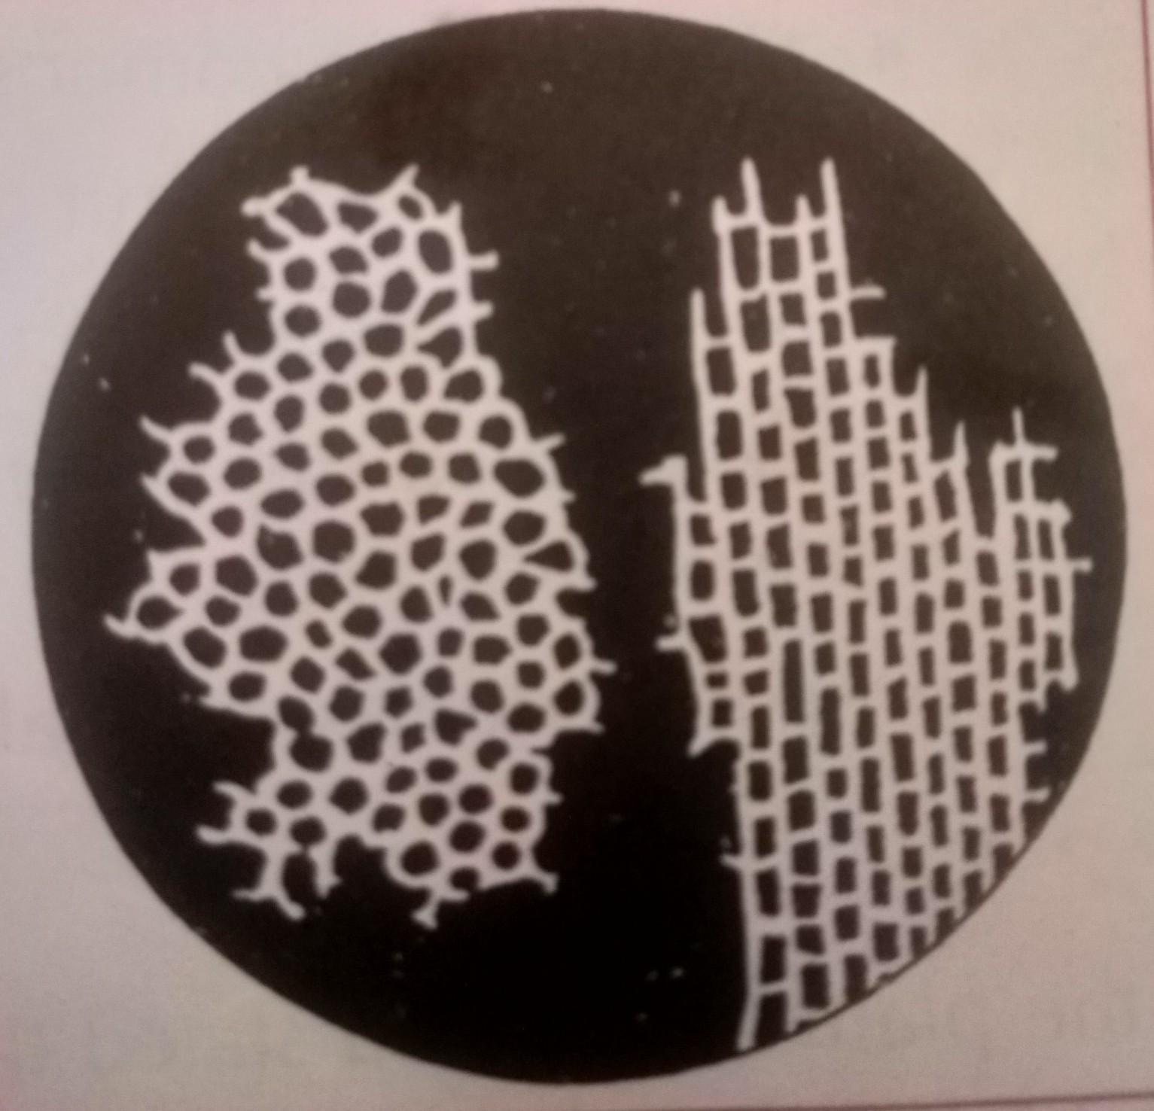
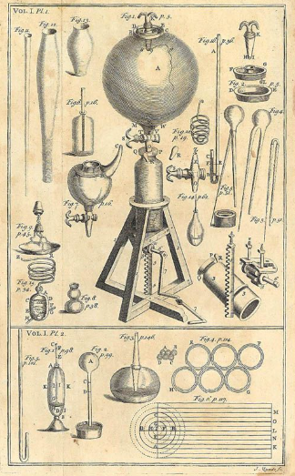
Boyle, Hooke, and the Power of Instrumentation
Robert Boyle: Boyle’s law via experiments with a vacuum pump.
Robert Hooke: Discovered cells with the microscope.
Showed the value of tools in extending human senses.

Slide 14
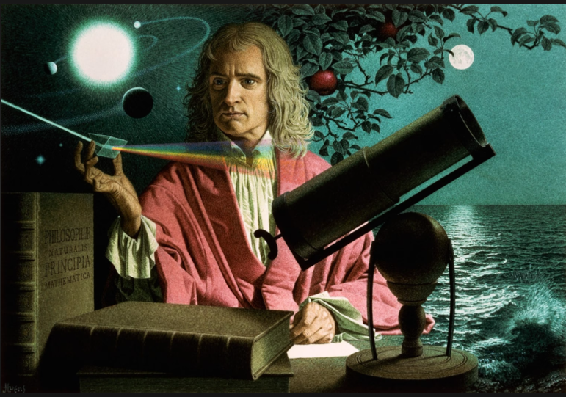
Isaac Newton and the Birth of Mathematical Physics
Newton’s laws of motion and universal gravitation, along with his development of calculus, revolutionized physics.
Established rules for scientific theories:
  Simplicity, universality, and inductive reasoning.
His work established the principles of mathematical physics and scientific methodology.

Slide 15
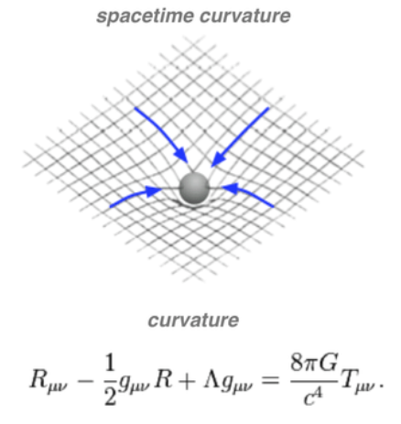
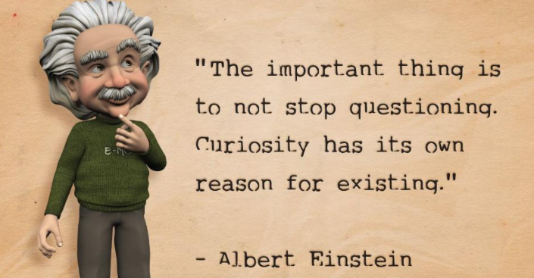
Einstein Supersedes Newton
Special Relativity: Unified space and time.
General Relativity: Replaced Newtonian gravity with spacetime curvature.
Einstein’s theories of relativity resolved contradictions in Newtonian physics and redefined our understanding of space, time, and gravity by Theoretical Asymmetry.
His work demonstrated the importance of foundational principles and thought experiments.

Slide 16
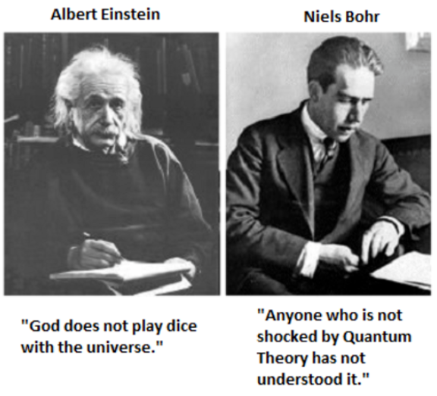
Quantum Uncertainty
Planck, Einstein, Bohr → Full quantum mechanics.
Challenged Newtonian determinism with uncertainty principles.
Quantum mechanics introduced indeterminacy at the microscopic level, challenging classical determinism.

Slide 17
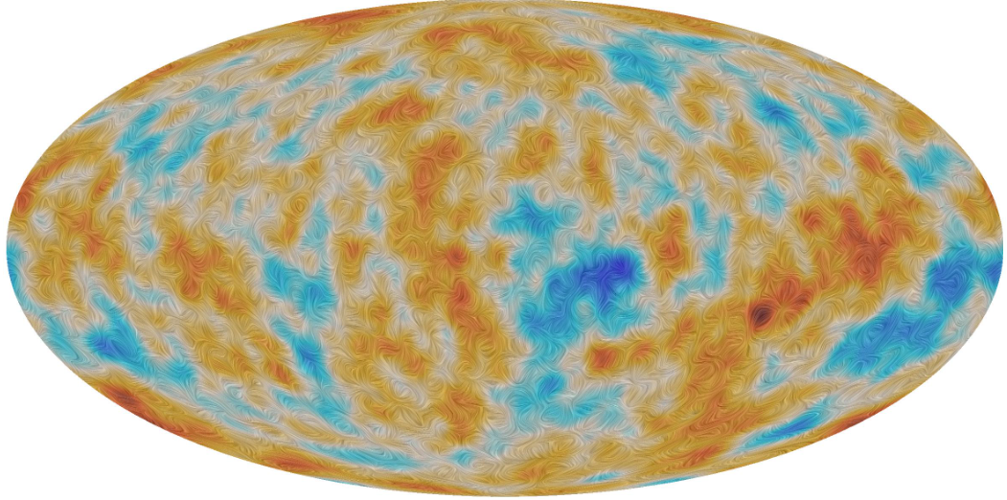
Big Bang Theory
Hubble: Discovered the expanding universe.
Penzias & Wilson: Detected Cosmic Microwave Background (CMB).
Solidified Big Bang theory as a scientific explanation of origins.

Slide 18
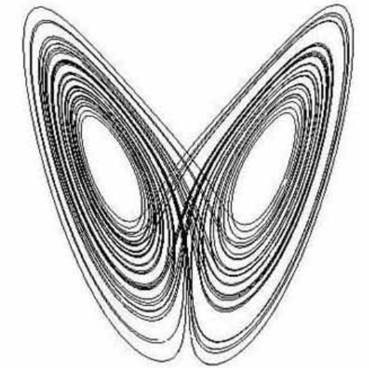
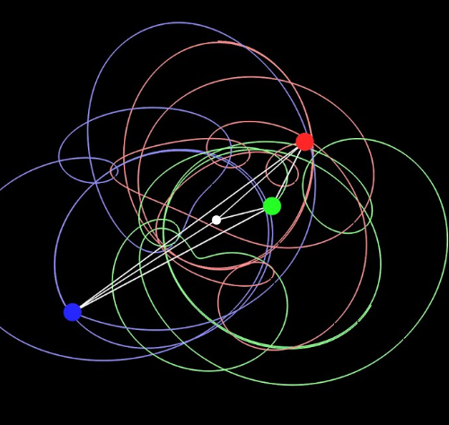
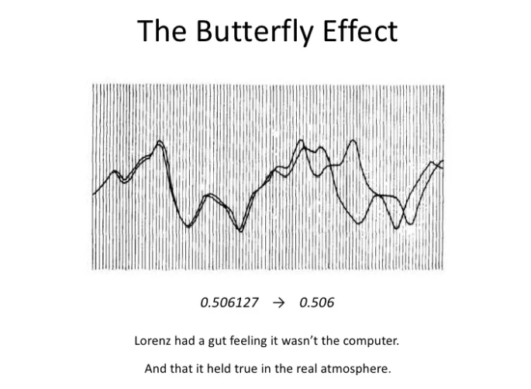
The Final Blow to Newtonian Physics
Edward Lorenz (1961): Small changes → Large effects (butterfly effect).
Chaos theory revealed that even deterministic systems can be unpredictable due to sensitivity to initial conditions.
Showed nature’s complexity beyond Newtonian ideals.

Slide 19
Reflection
The history of science is a testament to humanity’s relentless curiosity and ingenuity. Each milestone represents a step forward in our understanding of the nature, often challenging and superseding previous beliefs. Science evolves by questioning and improving past ideas.
From the ancient Greeks to modern physicists, the pursuit of knowledge has been driven by a combination of observation, experimentation, and theoretical innovation. As we continue to explore the mysteries of the universe, the lessons from this historical journey remind us of the importance of skepticism, creativity, and the willingness to embrace new paradigms.
The journey of science continues, seeking deeper truths about the nature.

