Slide 1
Understanding Paradoxes
by
Dr Hage Doley
Assistant Professor
Department of Physics
I. G. Govt. College, Tezu
hagedoley@gmail.com

Slide 2
Paradoxes
Etymology: From Greek roots:
"Para" = beyond/against
"Dox" = belief/opinion
Not always contradictory: Can be true yet counterintuitive

Slide 3
Types of Paradoxes
1. Veridical Paradox:
Counterintuitive but true.
Examples: Birthday Paradox, Newcomb’s Paradox, Hilbert’s Hotel.
2. Falsidical Paradox:
Appears logical but false.
Examples: Zeno’s paradoxes, classical physics misunderstandings.
3. Antinomy (Self-Contradictory):
Statements that contradict themselves.
Examples: Liar Paradox, Grandfather Paradox.

Slide 4
The Birthday Paradox
How many people should be in a room to have at least 50% of the chance of sharing the same birthday?
In a group of only 23 people, there is a 50.8% chance that at least two of them share the same birthday. This seems surprising because intuitively, one might think you’d need about half of 365 (roughly 180 people) to reach such a probability.

Slide 5
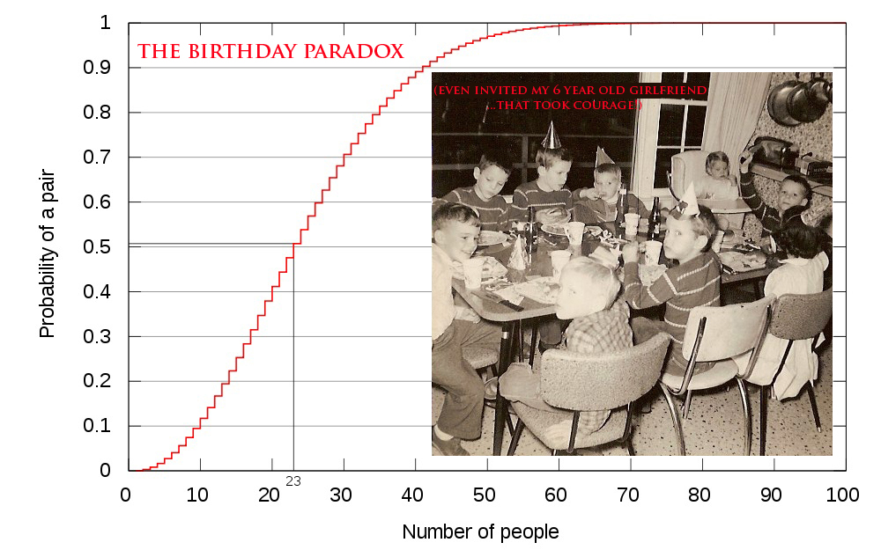
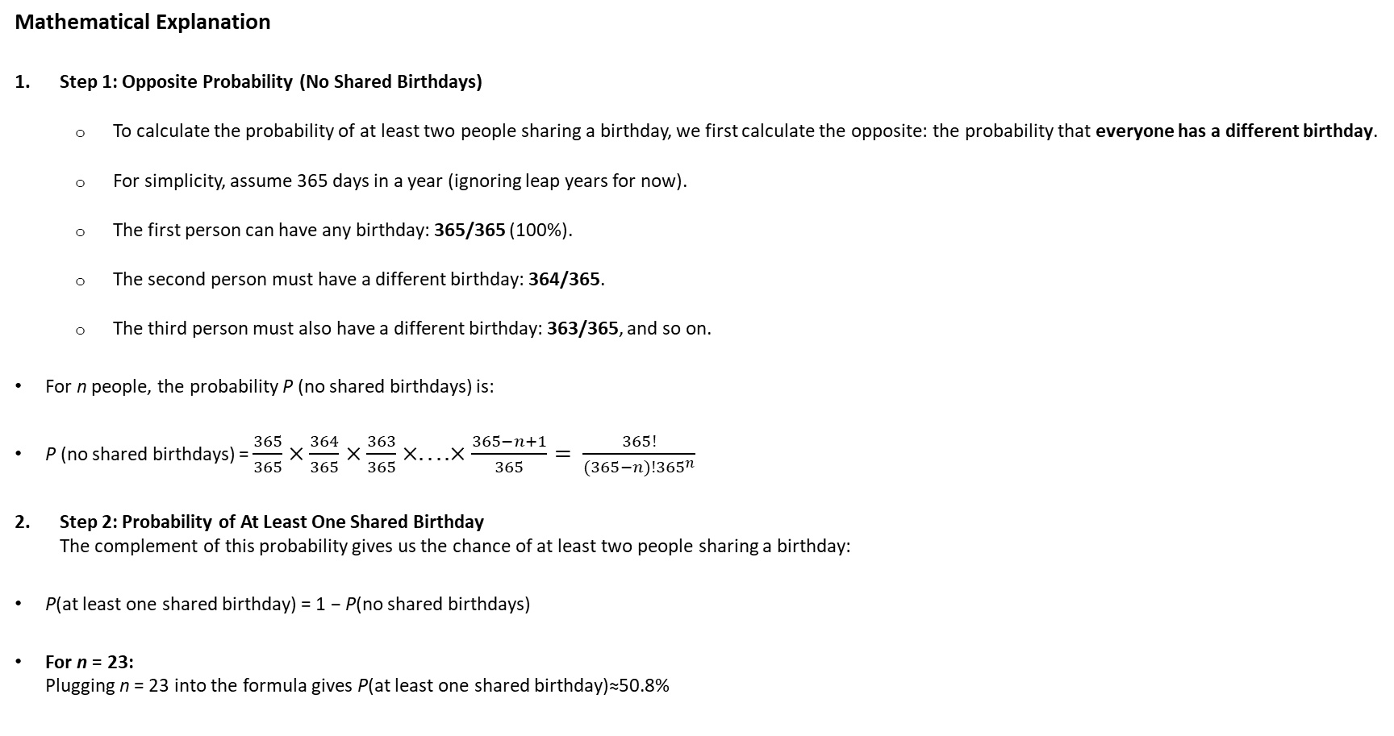
Mathematical Explanation
Step 1: Opposite Probability (No Shared Birthdays)
  To calculate the probability of at least two people sharing a birthday, we first calculate the opposite: the probability that everyone has a different birthday.
  For simplicity, assume 365 days in a year (ignoring leap years for now).
  The first person can have any birthday: 365/365 (100%).
  The second person must have a different birthday: 364/365.
  The third person must also have a different birthday: 363/365, and so on.
For n people, the probability P (no shared birthdays) is:
P (no shared birthdays) = $\frac{365}{365}×\frac{364}{365}×\frac{363}{365}×....×\frac{365−n+1}{365}= \frac{365!}{(365−n)!{365}^{n}}$
Step 2: Probability of At Least One Shared Birthday
The complement of this probability gives us the chance of at least two people sharing a birthday:
P(at least one shared birthday) = 1 − P(no shared birthdays)
For n = 23:
Plugging n = 23 into the formula gives P(at least one shared birthday)≈50.8%

Slide 6
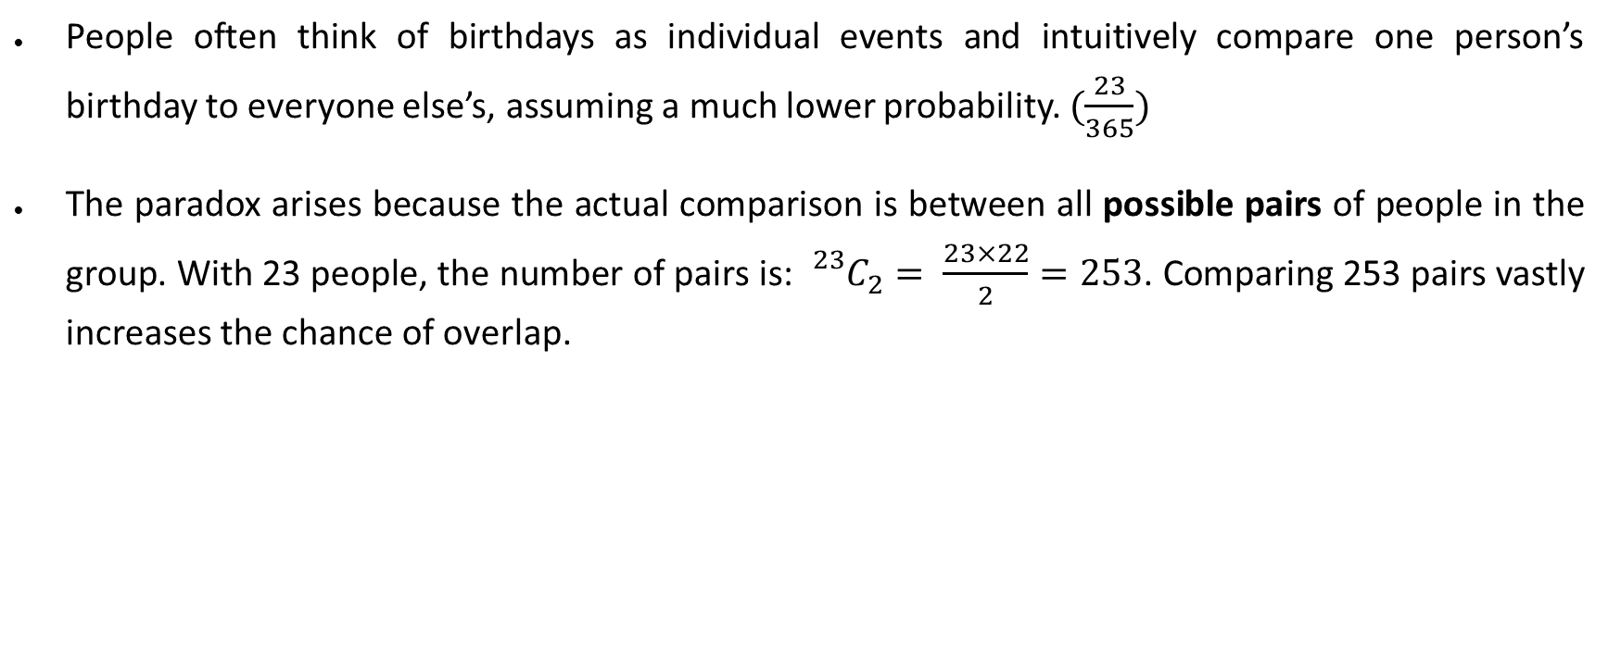
Why It Feels Counterintuitive
People often think of birthdays as individual events and intuitively compare one person’s birthday to everyone else’s, assuming a much lower probability. $(\frac{23}{365})$
The paradox arises because the actual comparison is between all possible pairs of people in the group. With 23 people, the number of pairs is: ${}_{}^{23}{C_{2}= \frac{23×22}{2}}=253$. Comparing 253 pairs vastly increases the chance of overlap.

Slide 7
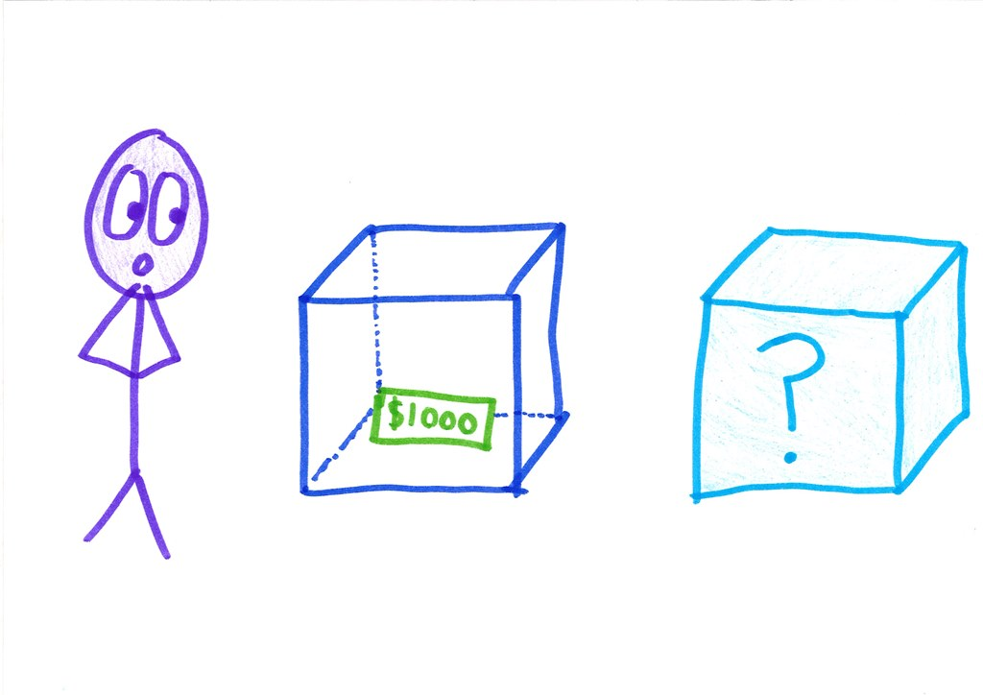
Newcomb’s Paradox:
Setup: There are two boxes:
  Box A (transparent) contains a visible $1,000.
  Box B (opaque) contains either $0 or $1,000,000.
A superintelligent Oracle predicts your choice:
  If the Oracle predicts you’ll take only Box B, it puts $1,000,000 in it.
  If it predicts you’ll take both boxes, it leaves Box B empty.
Dilemma: Do you trust the Oracle and take only Box B, or do you take both boxes to maximize your immediate utility?
Resolution: The debate hinges on whether you trust the Oracle’s perfect prediction:
  One-Boxers: They argue that since the Oracle is infallible, taking only Box B ensures $1,000,000.
  Two-Boxers: They argue that the Oracle’s prediction is fixed when you enter, so taking both boxes guarantees at least $1,000.
Logical resolution often sides with One-Boxers, assuming the Oracle's predictions are flawless.

Slide 8
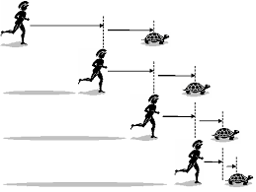
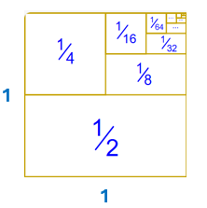
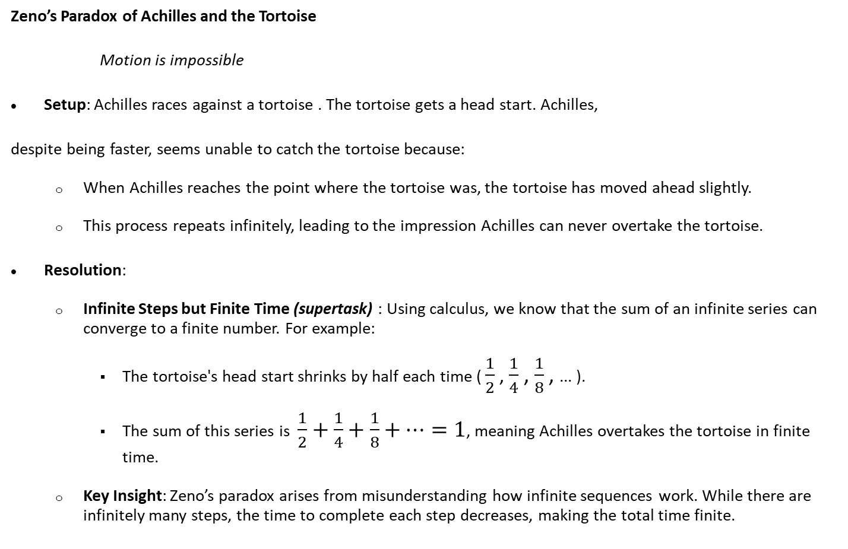
Zeno’s Paradox of Achilles and the Tortoise
Motion is impossible
Setup: Achilles races against a tortoise . The tortoise gets a head start. Achilles,
despite being faster, seems unable to catch the tortoise because:
  When Achilles reaches the point where the tortoise was, the tortoise has moved ahead slightly.
  This process repeats infinitely, leading to the impression Achilles can never overtake the tortoise.
Resolution:
  Infinite Steps but Finite Time (supertask) : Using calculus, we know that the sum of an infinite series can converge to a finite number. For example:
    The tortoise's head start shrinks by half each time ( $\frac{1}{2}$, $\frac{1}{4}$ , $\frac{1}{8}$ , ... ).
    The sum of this series is $\frac{1}{2}+\frac{1}{4}+\frac{1}{8}+…=1$, meaning Achilles overtakes the tortoise in finite time.
  Key Insight: Zeno’s paradox arises from misunderstanding how infinite sequences work. While there are infinitely many steps, the time to complete each step decreases, making the total time finite.

Slide 9
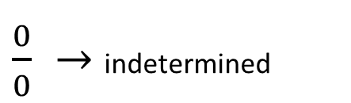
Prove 2 = 1
Let a = b
a² = ab
a² - b² = ab - b²
(a - b) (a + b) = b (a - b)
a + b = b
b + b = b
2b = b
$\frac{0}{0} →$ indetermined
2=1

Slide 10
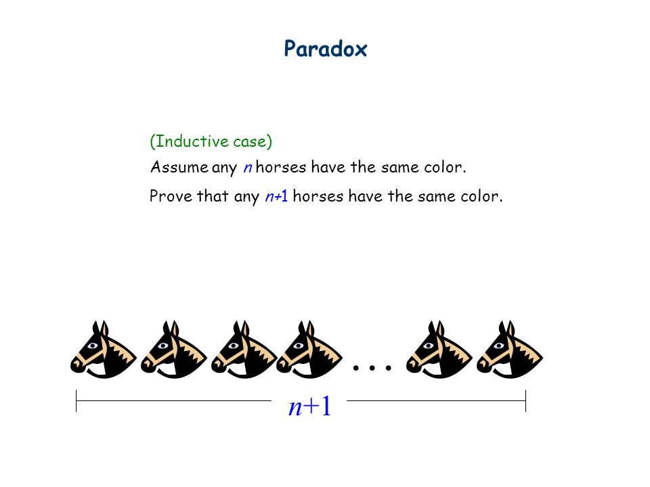
The "All Horses Are the Same Color" Paradox
The Claim: All horses are the same color.
Method Used: Mathematical Induction.
  Base Case (n = 1): One horse → All horses in the group are the same color. ✅
  Inductive Step: Assume true for n; prove for n+1:
    Split n+1 horses into two overlapping groups of n.
    Overlap ensures all n+1 horses are the same color.
The Flaw:
  For n=1, no overlap exists → Cannot ensure consistency.
  Logical gap breaks the induction.

Slide 11
Antinomies and Self-Referential Paradoxes
"This sentence is false":
  A classic example of a liar paradox. If the sentence is true, it must be false; if false, it must be true. This contradiction arises from self-reference and is central to discussions in logic and philosophy.
  Resolution attempts include frameworks like multi-valued logic or rejecting self-referential statements entirely.
Free Will vs. Predestination:
  This long-standing debate pits theological and philosophical notions of an omniscient deity against human autonomy. The apparent paradox emerges from:
    If all actions are preordained, choice is an illusion.
    If free will exists, divine omniscience seems undermined.
  Proposed resolutions often involve redefining the nature of time, knowledge, or causality (e.g., open theism or compatibilism).

Slide 12
Grandfather Paradox:
  A time-travel paradox: If you go back in time and kill your grandfather, you prevent your own existence, which negates your ability to kill him.
  Resolution attempts:
    Multiverse theory: Killing the grandfather splits the timeline, creating a new universe where you exist without causing contradictions in the original.
    Consistency principle: Time loops must be consistent, meaning you cannot alter past events in ways that negate your ability to time-travel.
Catch-22 Example:
  This situation illustrates a logical trap or bureaucratic absurdity where all options lead to failure.
  The military example: To avoid flying missions, you must prove insanity. But seeking to avoid danger proves rationality, disqualifying the claim.
  Real-life analogs:
    Needing experience to get a job, but needing a job to gain experience.
    Applying for credit requires credit history, but building credit history requires credit.

Slide 13
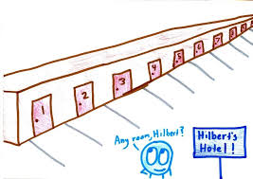
Hilbert's Hotel Paradox
This is a thought experiment demonstrating the counterintuitive properties of infinite sets.
Infinite Rooms Fully Occupied: If a hotel has infinite rooms and they are all occupied, you can still accommodate a new guest by moving each existing guest from room n to room n+1, freeing up room 1.
Infinite Guests Arrive: If an infinite number of guests arrive, you can still accommodate them by assigning each current guest in room n to room 2n (even-numbered rooms), freeing up all odd-numbered rooms for the new arrivals.
This paradox illustrates how infinity defies our finite intuition—showing that an infinite set can accommodate "more" elements without "running out of space."

Slide 14
There are as many even numbers as there are odd numbers, by one-to-one correspondence
1 | 3 | 5 | 7 | 9 | 11 | 13 | 15 | 17 | 19 | etc.
↕ | ↕ | ↕ | ↕ | ↕ | ↕ | ↕ | ↕ | ↕ | ↕
2 | 4 | 6 | 8 | 10 | 12 | 14 | 16 | 18 | 20 | etc.
1 | 2 | 3 | 4 | 5 | 6 | 7 | 8 | 9 | 10 | etc.
↕ | ↕ | ↕ | ↕ | ↕ | ↕ | ↕ | ↕ | ↕ | ↕
2 | 4 | 6 | 8 | 10 | 12 | 14 | 16 | 18 | 20 | etc.
The infinity of even numbers is exactly as large as the infinity of all numbers.
“ a part may be equal to the whole! ”

Slide 15
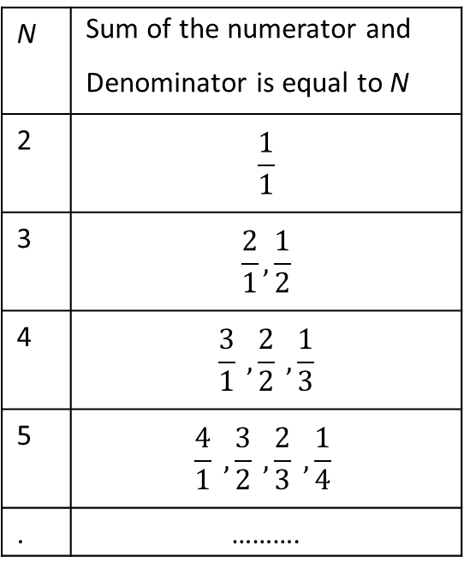
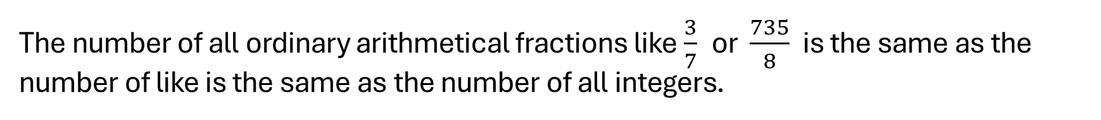
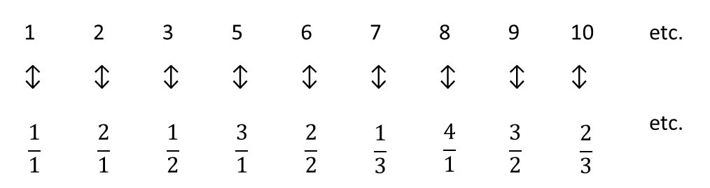
The number of all ordinary arithmetical fractions like $\frac{3}{7}$ or $\frac{735}{8}$ is the same as the number of like is the same as the number of all integers.
N | Sum of the numerator and Denominator is equal to N
2 | $$\frac{1}{1}$$
3 | $$\frac{2}{1}, \frac{1}{2}$$
4 | $$\frac{3}{1} , \frac{2}{2} , \frac{1}{3}$$
5 | $$\frac{4}{1} , \frac{3}{2} , \frac{2}{3} , \frac{1}{4}$$
. | ……….
1 | 2 | 3 | 5 | 6 | 7 | 8 | 9 | 10 | etc.
↕ | ↕ | ↕ | ↕ | ↕ | ↕ | ↕ | ↕ | ↕
$$\frac{1}{1}$$ | $$\frac{2}{1}$$ | $$\frac{1}{2}$$ | $$\frac{3}{1}$$ | $$\frac{2}{2}$$ | $$\frac{1}{3}$$ | $$\frac{4}{1}$$ | $$\frac{3}{2}$$ | $$\frac{2}{3}$$ | etc.

Slide 16
Establish one-to-one correspondence between the points on a line, say 1 inch long, and the sequence of integer numbers
N
1 | 0.39602595356….
2 | 0.57350763870….
3 | 0.99356786584….
4 | 0.25763200461.…
5 | 0.00005320562….
6 | 0.99035638567….
. | ………………………….
. | ………………………….
 | Not 3 | Not 7 | Not 3 | Not 6 | Not 5 | Not 6
 | ↓ | ↓ | ↓ | ↓ | ↓ | ↓ | etc.
0. | 5 | 2 | 7 | 4 | 0 | 7
The infinity of points on a line is larger, or stronger, than the infinity of all integer or fractional numbers.
There is the same number of points in lines one inch, one foot, or one mile long.

Slide 17
Countable and Uncountable Infinities
Countable Infinities: The integers, rational numbers, and natural numbers are countable because we can list them in a sequence (1-to-1 correspondence with natural numbers). (ℵ₀ )
  Rational numbers, for example, can be arranged in a grid where you zigzag through all possible numerators and denominators.
Uncountable Infinities: Real numbers (like all numbers between 0 and 1) are uncountable. Cantor's diagonal argument shows that no matter how you list real numbers, you can always construct a new one not in the list, proving that their infinity is larger than that of integers. (ℵ₁)

Slide 18
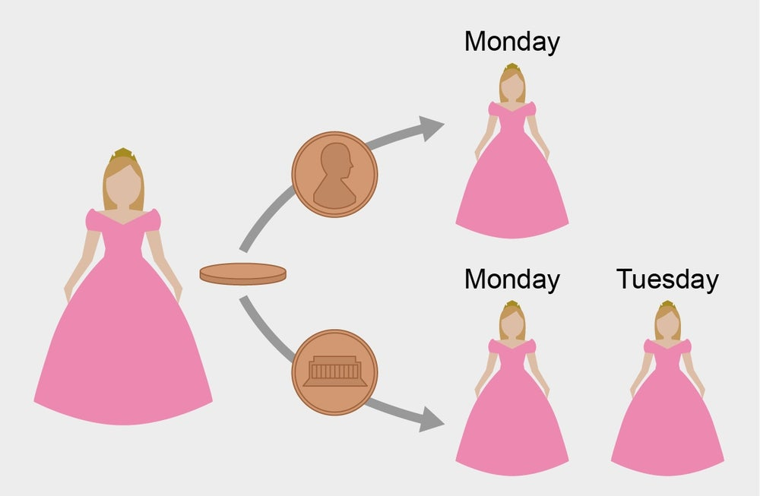
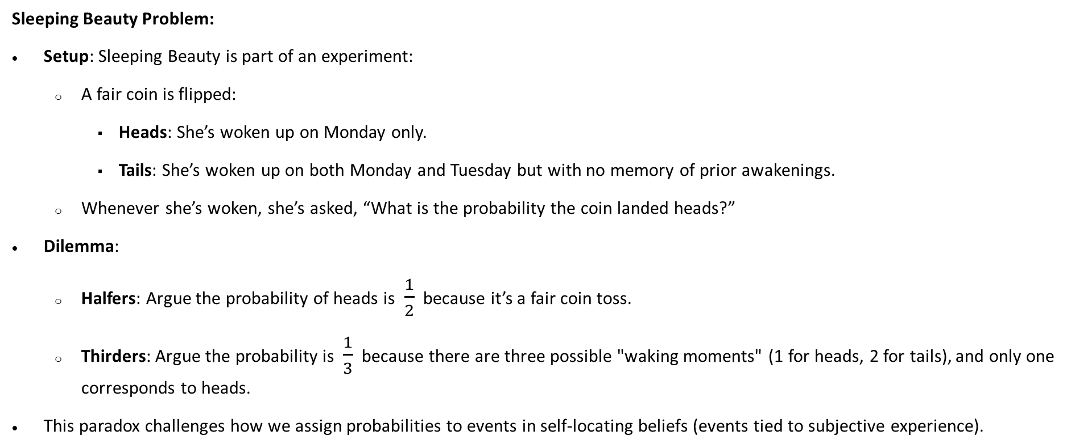
Sleeping Beauty Problem:
Setup: Sleeping Beauty is part of an experiment:
  A fair coin is flipped:
    Heads: She’s woken up on Monday only.
    Tails: She’s woken up on both Monday and Tuesday but with no memory of prior awakenings.
  Whenever she’s woken, she’s asked, “What is the probability the coin landed heads?”
Dilemma:
  Halfers: Argue the probability of heads is $\frac{1}{2}$ because it’s a fair coin toss.
  Thirders: Argue the probability is $\frac{1}{3}$ because there are three possible "waking moments" (1 for heads, 2 for tails), and only one corresponds to heads.
This paradox challenges how we assign probabilities to events in self-locating beliefs (events tied to subjective experience).

Slide 19
Thank you

